Slide 1
Designing Work to Achieve Well-being and Service Improvements
Talk by Graham Lowe, Ph.D.
Healthy Workplaces for Helping Professionals Conference
Edmonton, 13 October 2017
© 2017 The Graham Lowe Group

Slide 2
My focus today
How can you design work to improve both well-being and performance?
Ingredients of a successful healthy workplace strategy
Linking employee well-being to your organization’s performance
Your role leading healthy workplace change

Slide 3
Successful healthy workplace strategies
3

Slide 4
Workplace health promotion works
To answer the question, “Do workplace health promotion programs work?” a team of experts concluded that if these programs are well-designed, effectively executed and guided by evidence-based principles they can provide substantial health and financial benefits.
There is a huge difference between comprehensive workplace health promotion and “random acts of wellness.”
Goetzel, R. Z., Henke, R. M., Tabrizi, M., Pelletier, K. R., Loeppke, R., Ballard, D. W. et al. (2014). Do workplace health promotion (wellness) programs work? Journal of Occupational and Environmental Medicine 56, 927-934.

Slide 5
Promoting a ‘culture of health’
A best practice in workplace health promotion is for employers to promote a ‘culture of health’, which means “integrating health into the way an organization operates, thinks, and acts."
Kent K, Goetzel RZ, Roemer EC, Prasad A, & Freundlich N. (2016). Promoting healthy workplaces by building cultures of health and applying strategic communications. Journal of Occupational and Environmental Medicine 58(2):114-122.

Slide 6
Taking an integrated approach
“…companies that integrate their health and safety efforts, building a culture of health and wellness along with a culture of safety, are likely to have a competitive advantage in the marketplace.”
Fabius, R. M., et al. (2016). Tracking the Market Performance of Companies That Integrate a Culture of Health and Safety: An Assessment of Corporate Health Achievement Award Applicants. Journal of Occupational & Environmental Medicine, 58, 3-8.

Slide 7
New Alberta initiative…
Alberta Health’s Healthy Workplaces Program, to be launched early 2018 (www.albertahealthyworkplaces.ca):
    “In a Healthy Workplace, everyone understands that employee health and well- being are essential for business success and there is a comprehensive range of policies, resources and practices that promote good health among employees, support employees to reduce health risks behaviours, and provide a work environment that proactively prevents injury and illness.”

Slide 8
Workplace Health Framework
Physical work environment
Psycho-social work environment
Community connections
Personal health resources & behaviours
Healthy
&
Productive Workers
Organizational Success Factors
Leadership commitment
Integrated and comprehensive approach
Continuous improvement
Communication
Participation

Slide 9
Healthy Workplace Action Model
1.
ENGAGE
2.
ASSESS
3.
PLAN
5.
EVALUATE & IMPROVE
4. IMPLEMENT
Continuous &
sustainable
progress towards
healthy workplace
goals

Slide 10
3 Healthy Workplace Levels
The Alberta Healthy Workplaces Program is built around three levels, each representing successive stages of workplace health in terms of actions taken and progress achieved.
Commitment: The entry level, for organizations that are starting to build the foundation for a healthy workplace, beginning to address workplace health issues and ready to make a solid commitment to take necessary action.
Achievement: The intermediate level, for organizations that have advanced beyond the Commitment level, having developed and implemented a comprehensive healthy workplace plan or strategy.
Excellence: The advanced level, for those organizations that have met all the requirements for the Achievement level and can show measureable improvements in employee health and well-being, have the resources and capacity to sustain this progress, and have developed a culture of health.

Slide 11
Healthy Workplace Payoffs
Absenteeism
Presenteeism (at work but not being productive enough)
Health care costs
Employee health risks & status
Employee engagement
Employee morale
Work team performance
Employee loyalty & retention
Financial performance
Employer brand and reputation as good place to work
Commitment
Achievement
Excellence

Slide 12


Healthy workplace assessment tool
How the Assessment Tool Advances Organizations Through the 5-Step Healthy Workplace Action Model
LEVEL | Healthy Workplace Actions
 | Engage | Assess | Plan | Implement | Evaluate and Improve
Commitment | ✓ | ✓ | ✓
2. Achievement | ✓ | ✓ | ✓ | ✓
3. Excellence | ✓ | ✓ | ✓ | ✓ | ✓
Prepares organizations for enrolling in the Certificate of Recognition Health Standard

Slide 13
Linking well-being to your organization’s performance
13

Slide 14

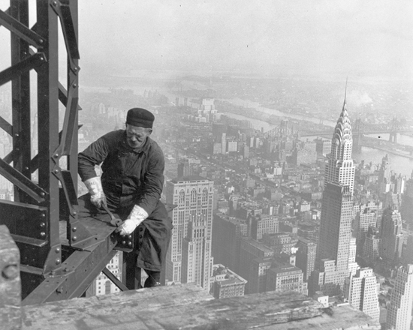
Changing perceptions of risk

Slide 15


Happy employees
See: Harvard Business Review, Jan-Feb 2012.

Slide 16
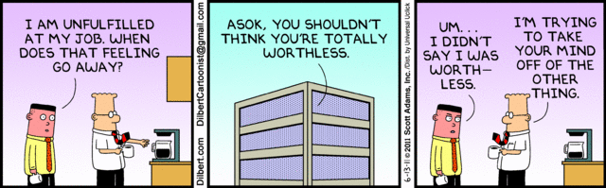
A big problem?

Slide 17


National Standard
  Psychologically healthy & safe workplaces…
  Foster psychological well-being while enhancing organizational performance
  Promote respectful relationships between staff, customers, the public
  Support staff experiencing psychological difficulties
  Source: Dan Bilsker and Merv Gilbert, Psychological Health & Safety: Action Guide for Employers

Slide 18
Assessing risks and identifying opportunities: workplace factors
  Psychological and social support
  Organizational culture
  Clear leadership and expectations
  Civility and respect
  Psychological job demands
  Growth and development
  Recognition and reward
  Involvement and influence
  Workload management
  Engagement
  Work/life balance
  Protection from violence, bullying and harassment
  Physical safety
Source: National Standard

Slide 19
Employee engagement – Edmonton PDD
2011 ‘YOUR VOICE’ employee survey, 8 Edmonton-area PDD agencies (n=835; 55% response rate)
7 items measure the emotional, rational and behavioural dimensions of employee engagement.
Engaged employees are satisfied, loyal, proud, inspired, feel their work is meaningful, share the organization’s values, and speak highly of the organization as a workplace.
High engagement is a triple-win: employees, clients and management benefit.

Slide 20
Engagement levels by occupation
The 7-item Engagement Scale (ES) has scores between 5 and 35.
These scores can be grouped into low, medium and high levels of engagement.
There are statistically significant differences in ES scores by agency and occupation (but not gender, age or seniority).

Slide 21
Engagement “drivers” – Edmonton PDD
These factors (ranked by importance) have the biggest impact on engagement:
Using the Engagement Scale, we can identify the specific features of job, work environment, management and organizational supports that have the biggest impact on employee engagement.
This analysis measures the “net” impact of each factor measured in the survey (i.e., after taking into account all other factors measured in the EES).
These factors are the “drivers” of employee engagement.
Understanding these “drivers” of engagement can help to plan improvements.
1. Management cares about the well-being of employees.
2. My job is interesting.
3. I trust the managers of this organization.
4. My job enables me to use my skills and abilities.
5. Satisfaction with work schedule.
6. Management keeps me informed about important issues.
7. I feel I belong to a team.

Slide 22
Action implications
  The survey identifies specific opportunities for improvement:
    Giving employees more say in decisions affecting their jobs
    More feedback and support for career development from supervisors
    Acting on employees’ input
    Keeping employees informed about important issues
    Valuing employees’ contributions
    Giving employees a fair hearing if they have a complaint.
  By addressing the above issues, management can build trust, demonstrate they care about employee well-being and foster engagement.

Slide 23

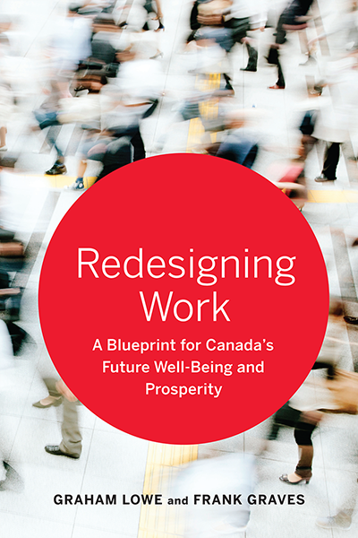
How can we design better jobs?
Need a blueprint for better work
  Ask workers
  Build on work experiences and values
www.ekos.com

Slide 24
Workers’ perspective on better jobs
www.ekos.com
Vision of a Great Job
Relationships
Tasks
Environment
Economics

Slide 25

What’s most valued?
www.ekos.com
Most important characteristics in deciding which job to choose:
A workplace free from harassment and discrimination
Work that gives a sense of pride & accomplishment
Good job security
Challenging and interesting work
A healthy and safe workplace
Senior management I can trust

Slide 26
Top motivators
www.ekos.com
What contributes most to making you look forward to work?
The people I work with
Challenging, interesting and varied work
Helping customers, clients, society

Slide 27
Your role
27

Slide 28
Enablers of healthy workplaces
Leadership commitment: Demonstrated commitment from leaders, backed by resources, to improve employee well-being and the embedding of health and safety goals into the organization’s culture.
Integrated and comprehensive approach: A commitment to achieving healthy workplace goals is integrated into the organization’s strategy and linked to safety, human resources and corporate social responsibility.
Participation: Active participation of employees and managers at all stages of the workplace health improvement process, and as users of healthy workplace programs and resources.
Communication: The organization and its leaders regularly communicate with workers about healthy workplace resources, initiatives and progress through multiple channels.
Continuous improvement: Achieving healthy workplace goals requires time, persistence, a continuous review of progress measures, and appropriate adjustments to initiatives.

Slide 29
Do your organization’s leaders…
  How do you promote psychological
  health & safety in your workplace?
Understand the business benefits of a psychologically healthy and safe workplace (PHSW)?
Demonstrate a personal commitment to a PHSW?
Communicate why and how a PHSW is strategically important?
Communicate how corporate values and ethical responsibilities require a PHSW?
Role model the skills and behaviours other managers need to support a PHSW?
Create accountability for actions contributing to a PHSW?
Take into account employee wellbeing when making corporate decisions and planning change?

Slide 30
Alberta Healthy Workplaces:
Achievement Level Requirements
Leadership & Culture | Fully Met | Partially Met | N/A
The organization’s senior leaders are committed to and actively participate in the company's health and wellness programs. | ✓
Senior leaders encourage employee participation in workplace health and wellness programs. | ✓
The organization has a Healthy Workplace Policy that addresses employee physical and psychological health, and is aligned with safety policies. | ✓
The organization has a dedicated annual budget for workplace health initiatives. | ✓
The organization has human resources dedicated to workplace health. | ✓
The organization recognizes employees and work teams for healthy and safe behaviours. | ✓
The organization provides managers at all levels with education and training regarding their role in creating a healthier workplace. | ✓

Slide 31
Low-cost actions you can take…
Live the corporate values and model healthy behaviours.
Engage employees, developing a shared vision of a healthy and safe workplace.
Design change to be healthy.
Expand occupational health and safety management systems to promote psychological health and safety.
Collaborate with HR and OHS to develop integrated approaches to employee well-being.
Analyze your OHS and HR metrics to demonstrate connections between health, safety and performance.
Strengthen your organization’s culture as the foundation for a healthy, safe and high-performing workplace.

Slide 32
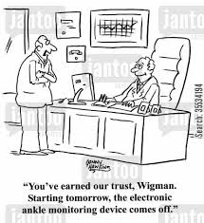
Model healthy behaviours
  Living the corporate values builds trust
32

Slide 33

Achieving sustainable success
  You can’t become a healthy organization by launching another program. It must become how you operate.

Slide 34
Questions & Comments
34

Slide 35

The Graham Lowe Group | www.grahamlowe.ca | glowe@grahamlowe.ca
www.creatinghealthyorganizations.ca
Follow me on Twitter: @HealthyOrgs
www.redesigningwork.ca
35
Notes:
35

